Slide 1
IP Networks

Slide 2
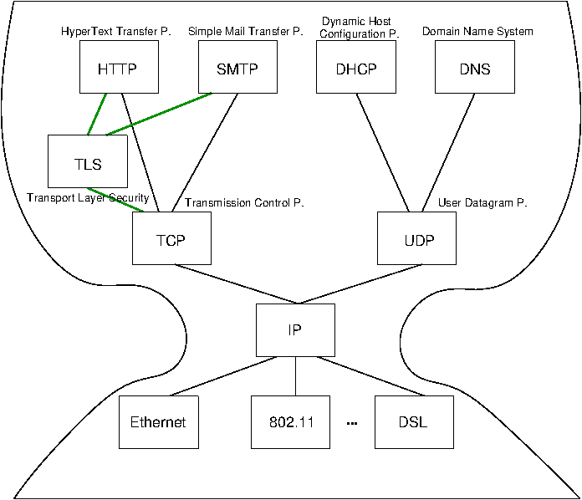
“Hourglass design” of the internet
Internet Architecture with narrow waist
IP is focal point
“Narrow waist”
Application independent!
Everything over IP
Network independent!
IP over everything
Source: https://oer.gitlab.io/DS/DS02-Internet.html#/slide-internet-architecture

Slide 3
IP Addresses on a network

Slide 4
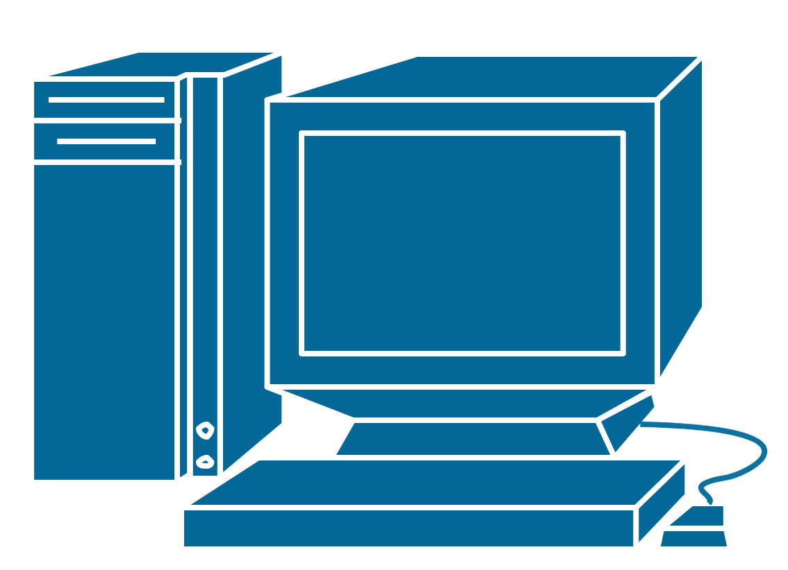
We want to communicate from one computer to another.

Slide 5
We want to communicate from one computer to another.
So we connect them to a network. Each computer can send data to the network and see data from other computers on the network.

Slide 6
100
2
15
1
We want to communicate from one computer to another.
So we connect them to a network. Each computer can send data to the network and see data from other computers on the network.
The computers are each given a number. The number is used to see, who sends data and who should receive it.

Slide 7
From: 100
To: 15
Data: hello
100
2
15
1

Slide 8
100
2
15
1
From: 100
To: 15
Data: hello
From: 100
To: 15
Data: hello
From: 100
To: 15
Data: hello

Slide 9
Not for me.
Ignore!
For me ☺
Accept data.
Not for me.
Ignore!
100
2
15
1
From: 100
To: 15
Data: hello
From: 100
To: 15
Data: hello
From: 100
To: 15
Data: hello

Slide 10
IPv4 addresses
192.168.1.100
192.168.1.2
192.168.1.15
192.168.1.1
IPv4 addresses are 32 bits long. They are written as 4 bytes.
E.g. 192.168.1.100

Slide 11
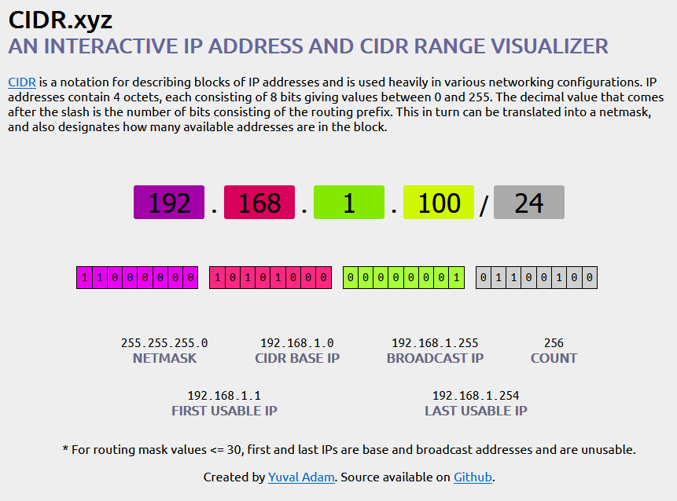
IP Address format
Networks can be split in to subnets. A subnet has an IP address range, which are the addresses usable in that network.
Data is routed inside a subnet.
The 32 bit IP addresses used in the subnet is split in NETWORK and HOST parts.
The 32 bits set to 1 in the NETMASK specifies the NETWORK part. The bits set to 0 defines the HOST parts.
The NETWORK part of an address can also be specified in CIDR format (Classless Inter-Domain Routing).
The IP address ending with .0 or .255 can not be used by a HOST.
https://cidr.xyz/

Slide 12
Local IP Networks
Portions of the IPv4 space are reserved for specific uses.
Loopback
127.0.0.0 to 127.255.255.255
Typically 127.0.0.1 is “loopback” or “localhost”
Private networks
10.0.0.0 to 10.255.255.255
172.16.0.0 to 172.31.255.255
192.168.0.0 to 192.168.255.255
Any computer that is not hooked up to the internet directly (any computer that goes through a router or other NAT system) can use these addresses at will.
Source: https://www.digitalocean.com/community/tutorials/understanding-ip-addresses-subnets-and-cidr-notation-for-networking
Notes:
There are also some portions of the IPv4 space that are reserved for specific uses.
One of the most useful reserved ranges is the loopback range specified by addresses from 127.0.0.0 to 127.255.255.255. This range is used by each host to test networking to itself. Typically, this is expressed by the first address in this range: 127.0.0.1.
Each of the normal classes also have a range within them that is used to designate private network addresses. For instance, for class A addresses, the addresses from 10.0.0.0 to 10.255.255.255 are reserved for private network assignment. For class B, this range is 172.16.0.0 to 172.31.255.255. For class C, the range of 192.168.0.0 to 192.168.255.255 is reserved for private usage.
Any computer that is not hooked up to the internet directly (any computer that goes through a router or other NAT system) can use these addresses at will.

Slide 13
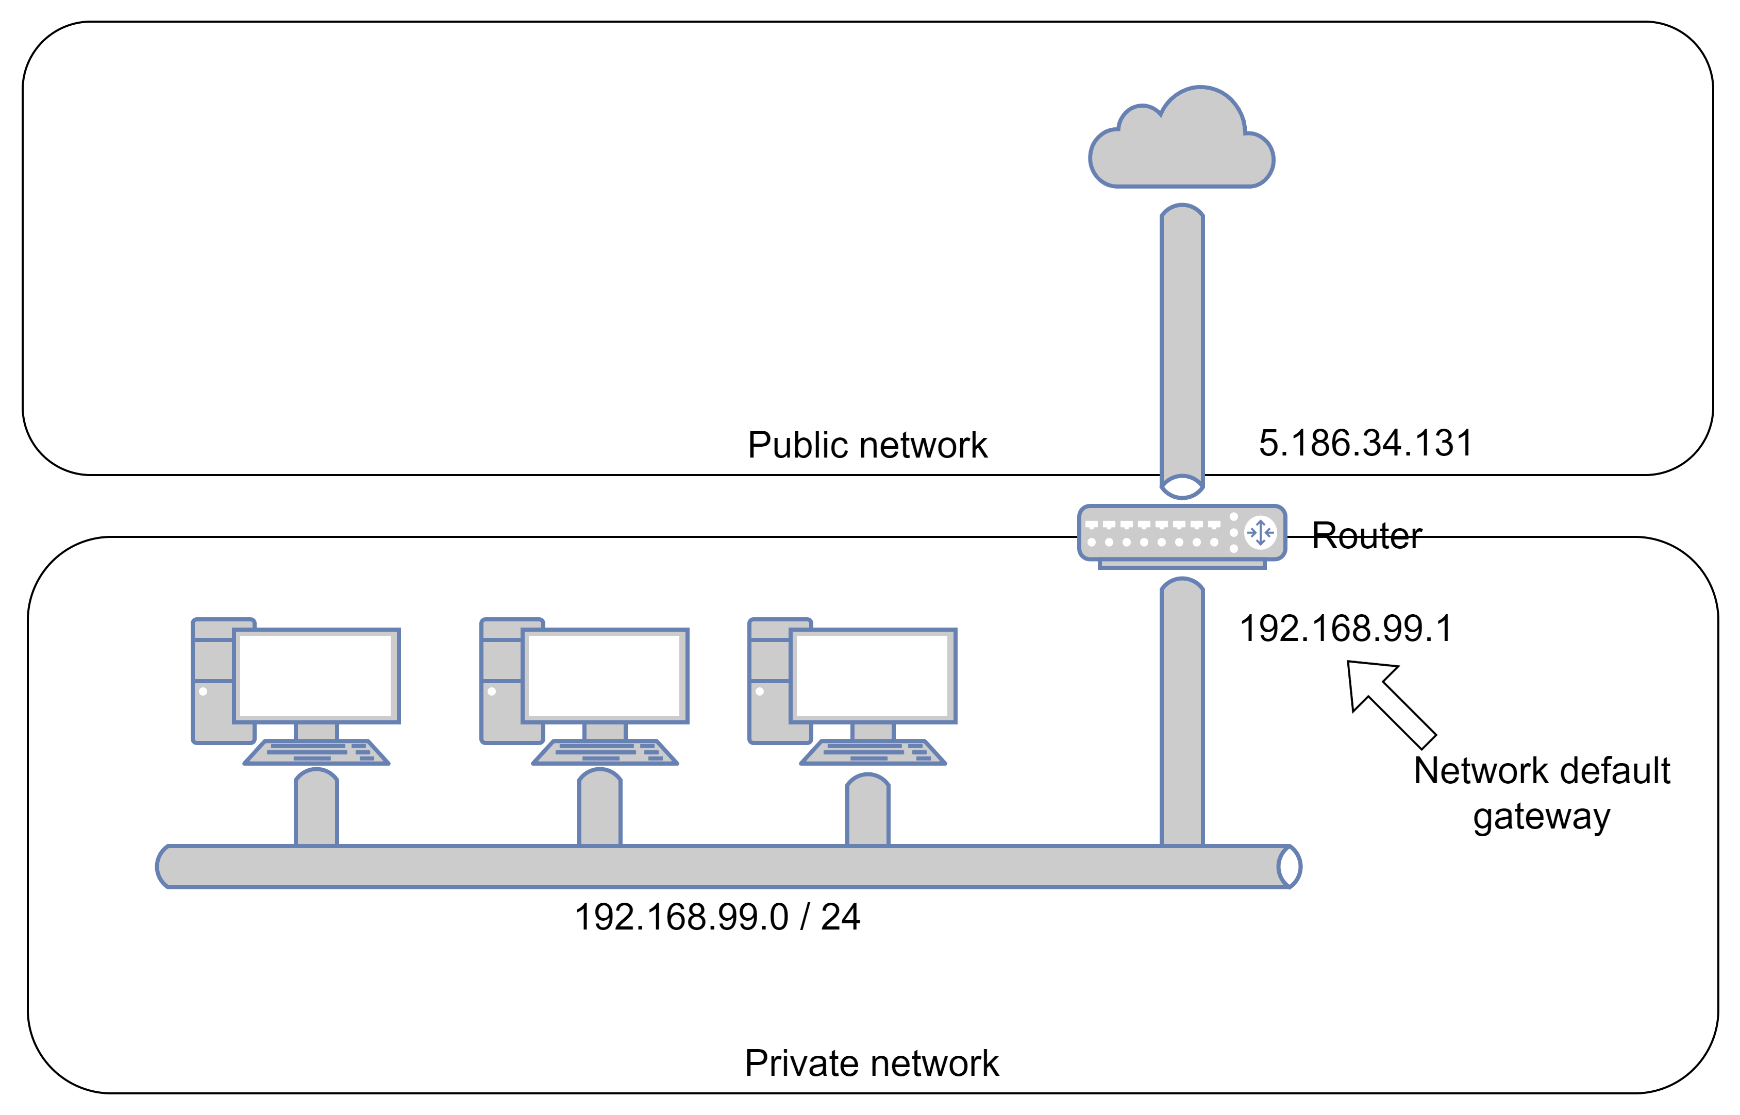
Public address vs. Local network address
Michael’s network.
192.168.99.0/24 is local addresses. They are managed by Michael.
5.186.34.131 is the public address. It is managed by Fibia (the internet provider).

Slide 14


Exercise
Exercise:
Find your LAN IP address and exchange address with another student.
What subnet are you on?
Ping each others machines
Ping is probably blocked in your windows firewall.
Try to ping 8.8.8.8 (google DNS) or Michaels Raspberry Pi if he remembered to bring it.
Find your external (WAN) IP Address using https://www.whatsmyip.org/ or https://ifconfig.me
Linux / Mac: Windows:
Notes:
https://www.thewindowsclub.com/how-to-allow-pings-icmp-echo-requests-through-windows-firewall

Slide 15
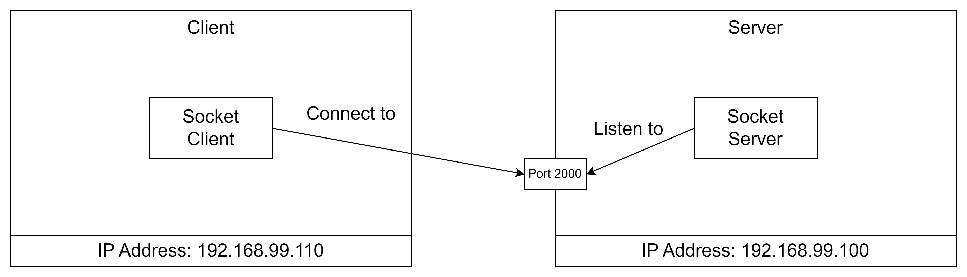
Ports
A machine has an IP address and 65535 Ports.
A program on a machine can listen to a specific port.
A program on another machine will specify the IP address and port it wants to communicate with.

Slide 16
Reserved ports
Ports from 0 to 1023 are reserved.
Examples:
20 FTP — Data
21 FTP — Control
22 SSH Remote Login Protocol
23 Telnet
25 Simple Mail Transfer Protocol (SMTP)
37 Time
53 Domain Name System (DNS)
80 HTTP
110 POP3
119 Newsgroup (NNTP)
443 HTTPS
546 DHCP Client
547 DHCP Server
Wikipedia has a complete list of reserved ports:
https://en.wikipedia.org/wiki/List_of_TCP_and_UDP_port_numbers

Slide 17
TCP / IP
Transmission Control Protocol (TCP) is a transport protocol that is used on top of IP to ensure reliable transmission of packets.
It handles retransmission of lost packages, reception of out-of-order packages and congestion control.

Slide 18
UDP / IP
User Datagram Protocol (UDP) is a lightweight data transport protocol that works on top of IP.
Detects and discards corrupt packages. Does not handle lost or out of order packages.
It's often used for time-sensitive applications (such as real-time video streaming) where speed is more important than accuracy.

Slide 19
Address assignment
DHCP
MAC address
Naming
DNS lookup

Slide 20
Example router setup

Slide 21
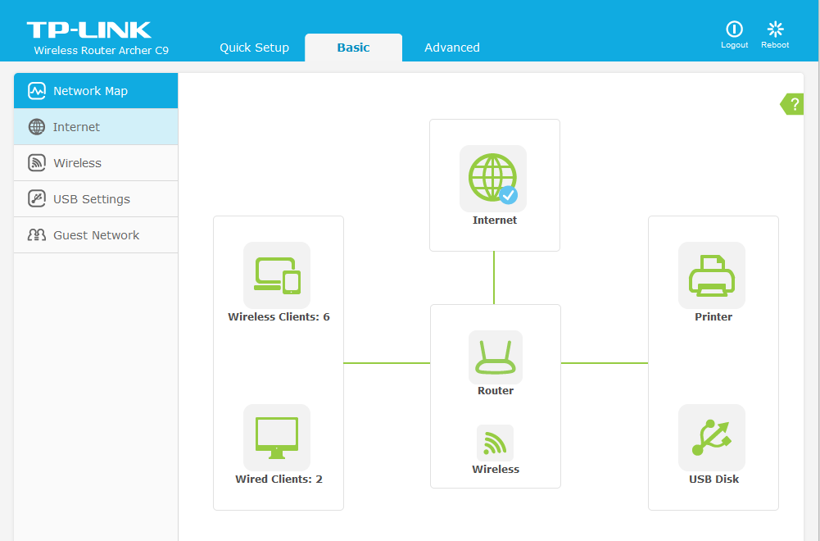

Slide 22
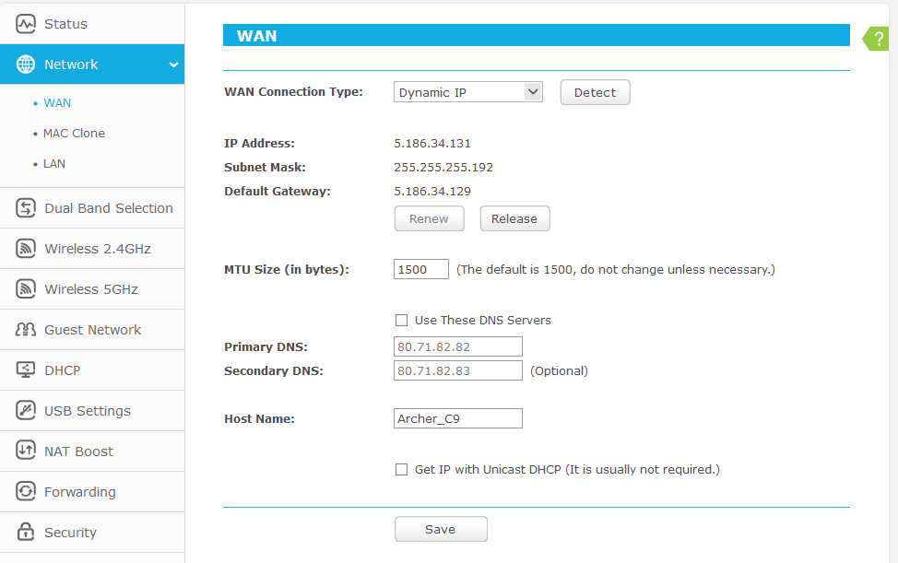

Slide 23
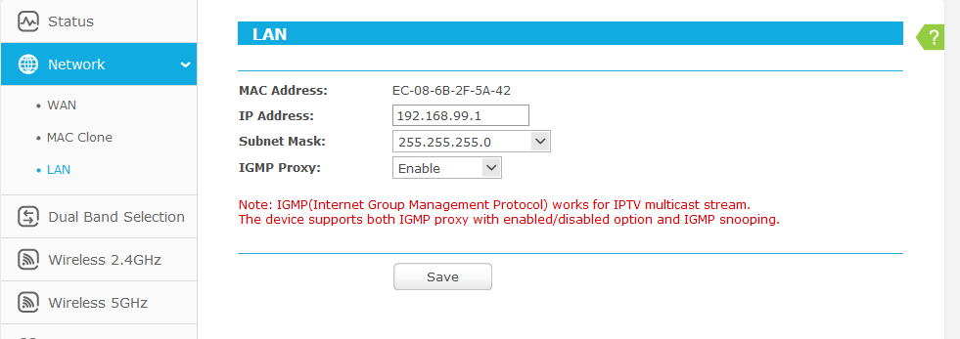

Slide 24
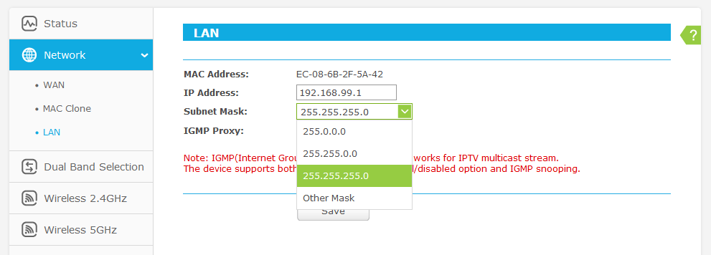

Slide 25
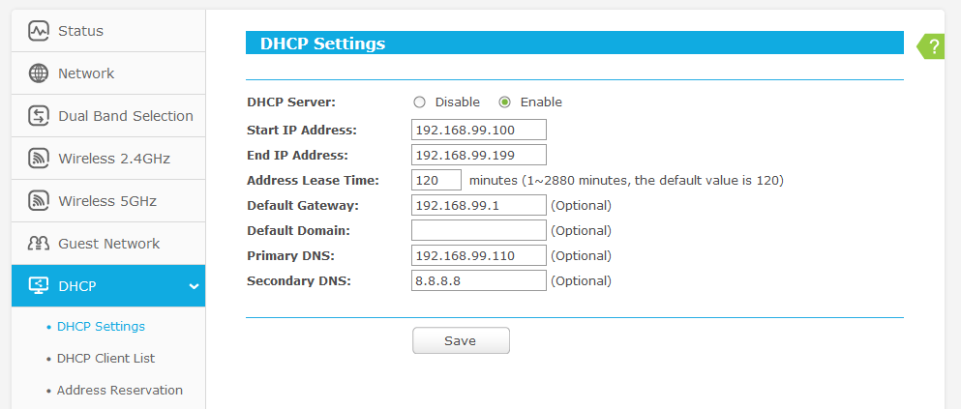

Slide 26
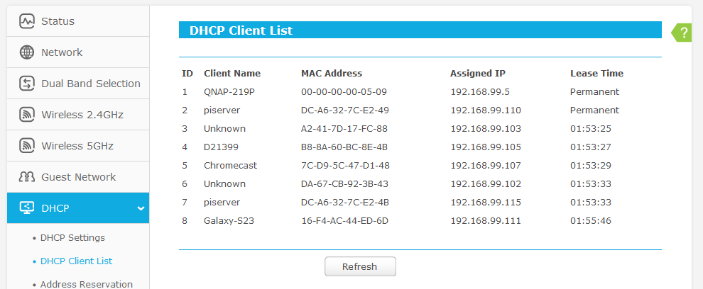

Slide 27
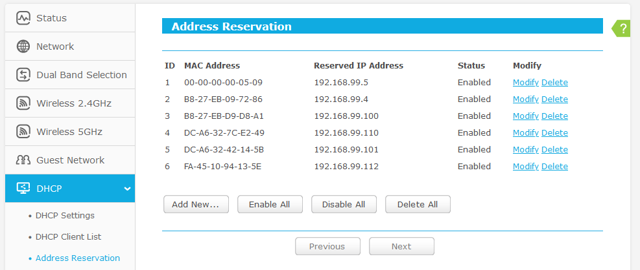

Slide 29
References and image sources
https://www.digitalocean.com/community/tutorials/understanding-ip-addresses-subnets-and-cidr-notation-for-networking
https://fab.cba.mit.edu/classes/961.04/people/neil/ip.pdf
https://iximiuz.com/en/posts/computer-networking-101/
https://www.youtube.com/watch?v=PwWhJEJVGl4
https://www.youtube.com/watch?v=NyZWSvSj8ek
https://www.youtube.com/playlist?list=PL7zRJGi6nMRzg0LdsR7F3olyLGoBcIvvg

